Slide 1

Tableau 2020.1
Sit back, hold on, and enjoy the data.

Slide 2
The role of the data communicator is complex. The goal should be to create “information experiences” that transform how audiences think about a subject and make better decisions.
- Zach Gemignani, juice analytics

Slide 3

Kristy McGee
I see data. I see data EVERYWHERE
Nashville Unicorn
Reformed Accountant
Data Geek
Mother of 2 heathens
Leader of the Nashville Tableau User Group for 5 years

Slide 4
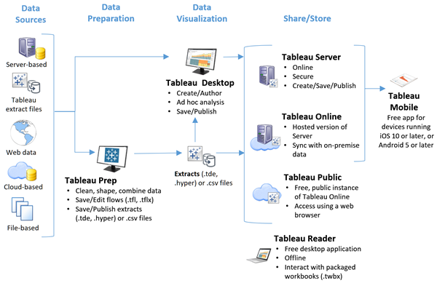
Tableau Platform

Slide 5
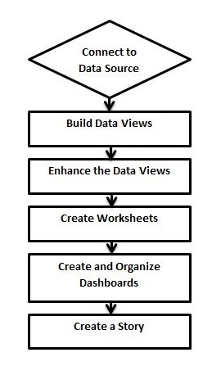
Sheets, Dashboards, and Stories

Slide 6
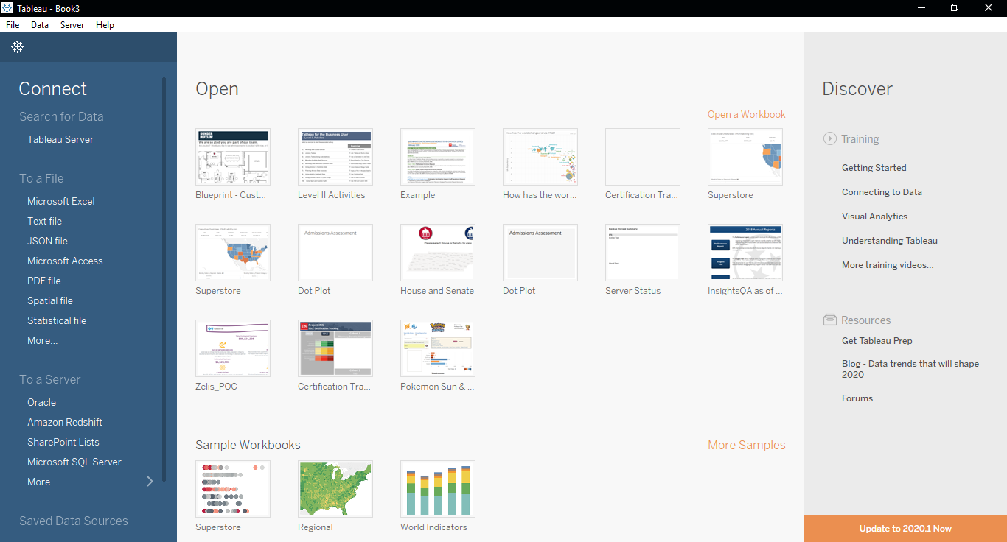
Tableau and behold – the Opening Screen
Notes:
Also speak to how you get to the ‘start page’ as well as the datasource page at the bottom

Slide 7
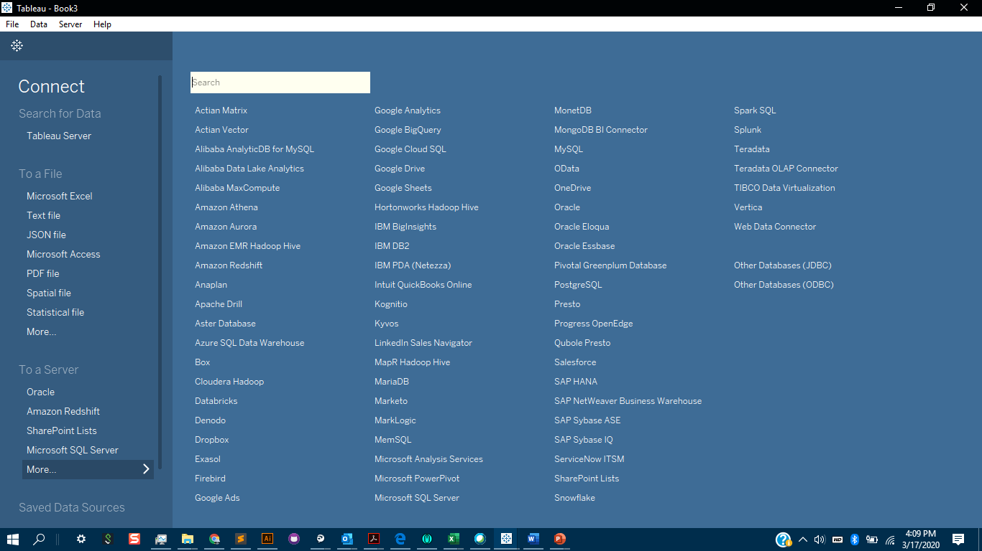
Connecting to Data
Notes:
Also speak to how you get to the ‘start page’ as well as the datasource page at the bottom

Slide 8
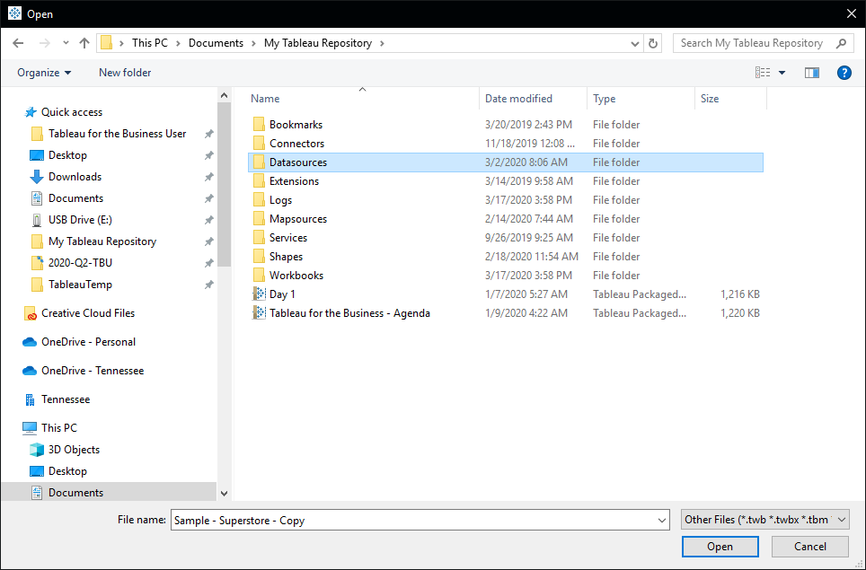
My Tableau Repository
Custom Shapes, Mapsources, Extensions, and Datasources
Notes:
Also speak to how you get to the ‘start page’ as well as the datasource page at the bottom

Slide 9
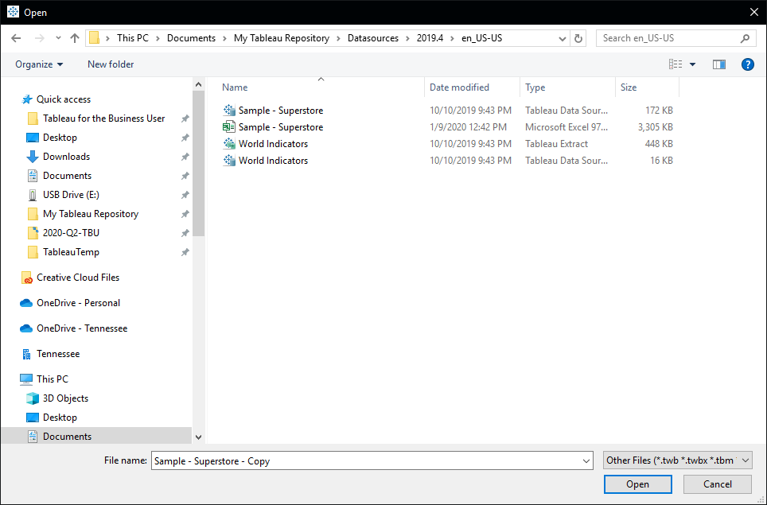
Ahhh, Superstore…
Saved data sources and the default files are saved in this location
Notes:
Also speak to how you get to the ‘start page’ as well as the datasource page at the bottom

Slide 10
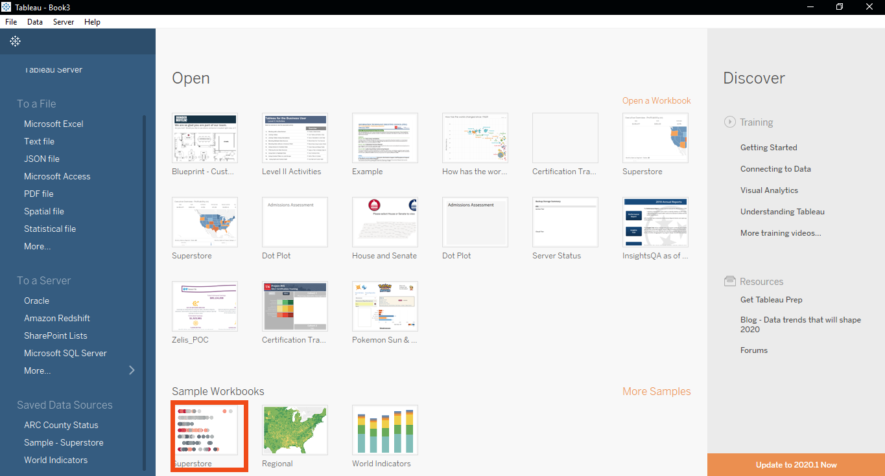
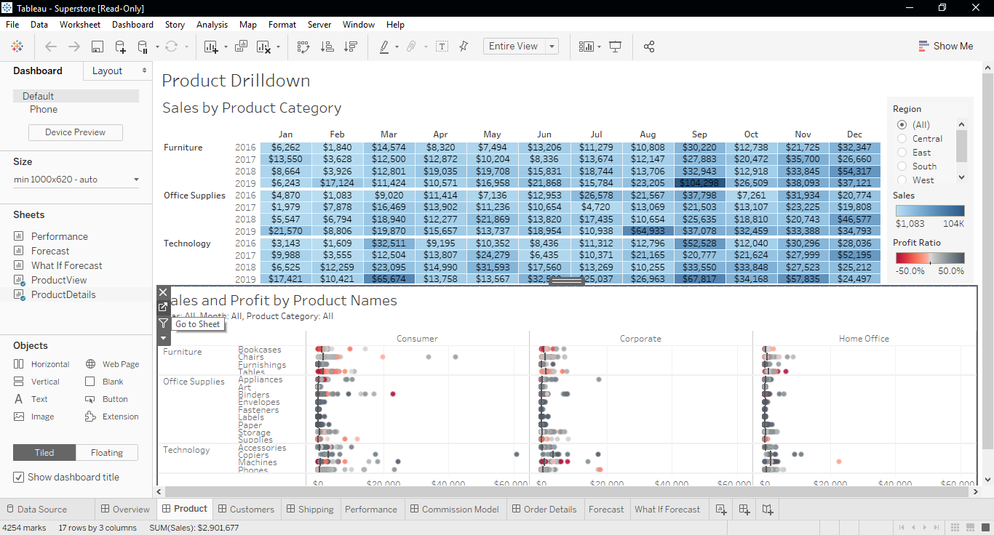
Sample Workbooks
Notes:
Also speak to how you get to the ‘start page’ as well as the datasource page at the bottom

Slide 11
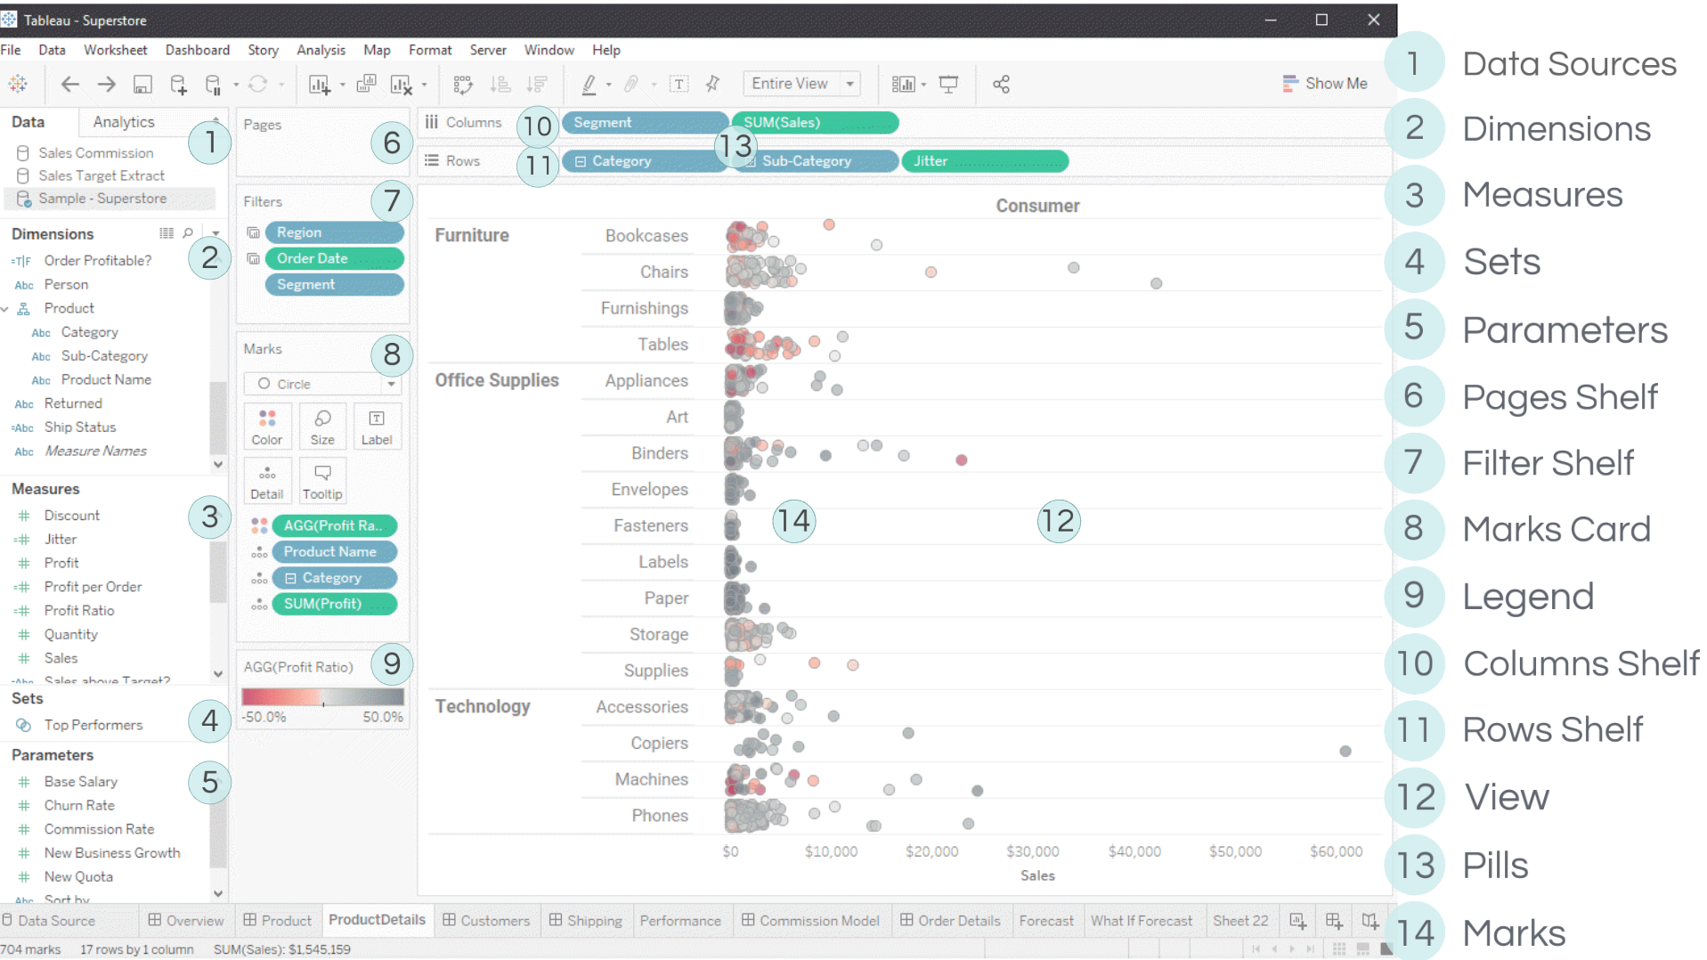
Anatomy of a View
Notes:
Also speak to how you get to the ‘start page’ as well as the datasource page at the bottom

Slide 12
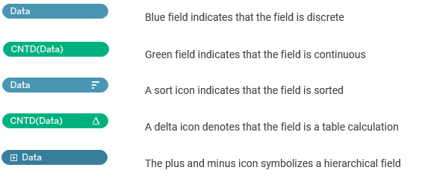
Visual Field Cues

Slide 13
File and Data Types
Type and Extension | Description
Tableau workbooks (.twb) | Contain one or more worksheets and dashboards, and always refer to data outside of the workbook itself.
Tableau Packaged Workbooks (.twbx) | Contain a workbook along with any supporting local file data sources and background images.
Tableau Data Extract (.hyper) | Local copy of an entire data source or a subset that you can use to share data or work offline and improve performance and efficiency.
Tableau Data Connection (.tds) | The underlying data and store metadata related to the data source.
File Types
Data Types
Notes:
File Type and Extension
Description
Tableau workbooks (.twb)
Contain one or more worksheets and dashboards, and always refer to data outside of the workbook itself.
Tableau Packaged Workbooks (.twbx)
Contain a workbook along with any supporting local file data sources and background images. This format is the best way to package your work for sharing with others who don’t have access to the data.
Tableau Data Extract files (.hyper or legacy .tde)
Local copy of an entire data source or a subset that you can use to share data or work offline and improve performance and efficiency.
Tableau Data Connection (.tds) files
The underlying data and store metadata (that is, any data customizations you have made in the workbook, such as groups, comments, sets, and so forth) related to the data source. Also serves as a short cut for quickly connecting to data sources you use often.

Slide 14
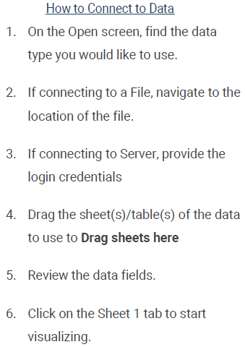
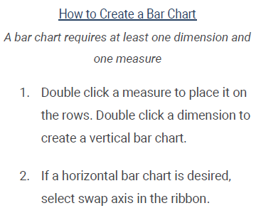
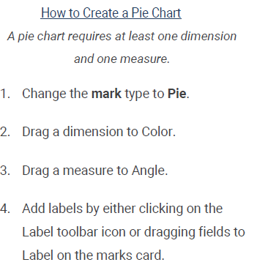
Quick Reference Guide
Notes:
File Type and Extension
Description
Tableau workbooks (.twb)
Contain one or more worksheets and dashboards, and always refer to data outside of the workbook itself.
Tableau Packaged Workbooks (.twbx)
Contain a workbook along with any supporting local file data sources and background images. This format is the best way to package your work for sharing with others who don’t have access to the data.
Tableau Data Extract files (.hyper or legacy .tde)
Local copy of an entire data source or a subset that you can use to share data or work offline and improve performance and efficiency.
Tableau Data Connection (.tds) files
The underlying data and store metadata (that is, any data customizations you have made in the workbook, such as groups, comments, sets, and so forth) related to the data source. Also serves as a short cut for quickly connecting to data sources you use often.

